Slide 1
React Advance
Banuprakash c
banu@lucidatechnologies.com
banuprakashc@yahoo.co.in

Slide 2
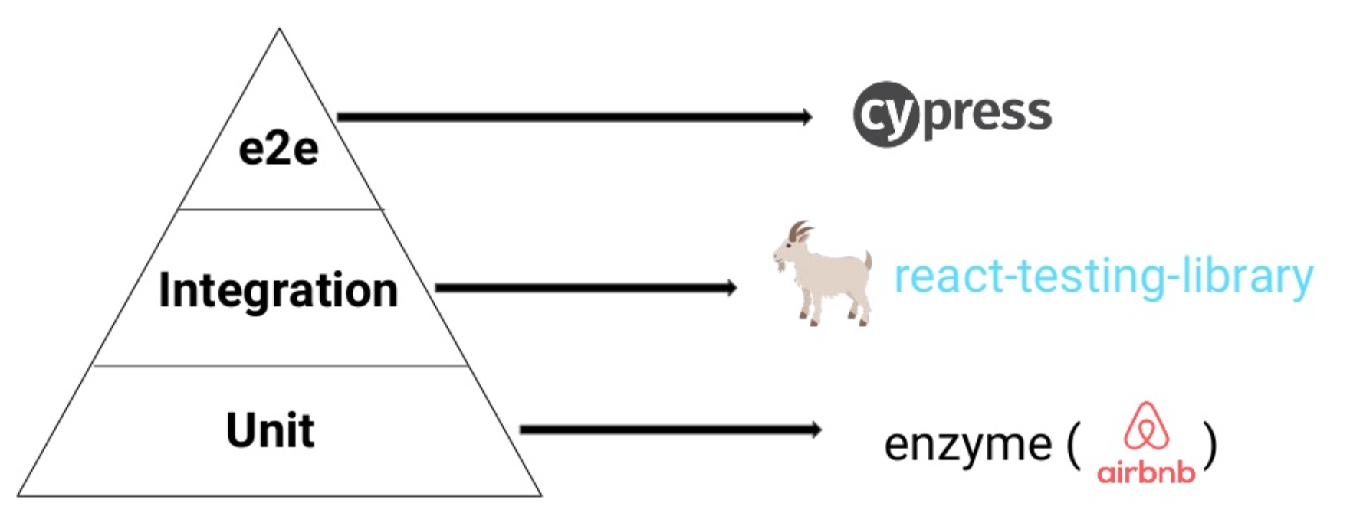
React Testing

Slide 3
react-testing-library
The react-testing-library is a very light-weight solution for testing React components.
It provides light utility functions on top of react-dom and react-dom/test-utils, in a way that encourages better testing practices.
This library encourages your applications to be more accessible and allows you to get your tests closer to using your components the way a user will, which allows your tests to give you more confidence that your application will work when a real user uses it.

Slide 4
REACT TESTING LIBRARY
The render() method
RTL's render function takes any JSX to render it. Afterward, you should have access to the React component in your test.
import React from 'react';
import { render, screen } from '@testing-library/react';
import App from './App';
describe('App', () => {
test('renders App component', () => {
render(<App />);
screen.debug();
});
});

Slide 5
REACT TESTING LIBRARY: SELECTING ELEMENTS
Returns an element or error
getByText
getByRole
getByLabelText
getByPlaceholderText
getByAltText
getByDisplayValue
getByTestId
Returns an element or null
queryByText
queryByRole
queryByLabelText
queryByPlaceholderText
queryByAltText
queryByDisplayValue
queryByTestId
For multiple elements
getAllBy
queryAllBy

Slide 6
Assertive Functions
All assertive functions of JEST
Extra package assertions
toBeDisabled
toBeEnabled
toBeEmpty
toBeEmptyDOMElement
toBeInTheDocument
toBeInvalid
toBeRequired
toBeValid
toBeVisible
toContainElement
toContainHTML
toHaveAttribute
toHaveClass
toHaveFocus
toHaveFormValues
toHaveStyle
toHaveTextContent
toHaveValue
toHaveDisplayValue
toBeChecked
toBePartiallyChecked
toHaveDescription

Slide 7
REACT TESTING LIBRARY: FIRE EVENT
RTL's fireEvent function to simulate interactions of an end user.
The fireEvent function takes an element and an event
fireEvent.click(screen.getByRole(‘button’));
fireEvent.change(screen.getByRole('textbox'), {
target: { value: 'JavaScript' },
});

Slide 8
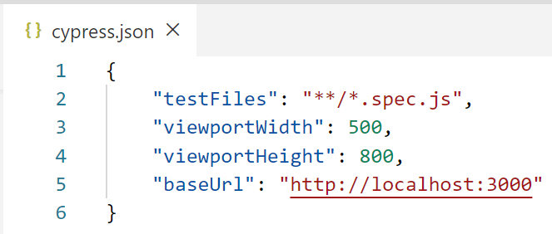
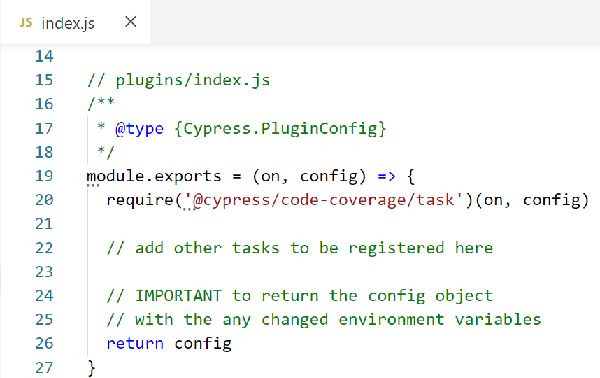
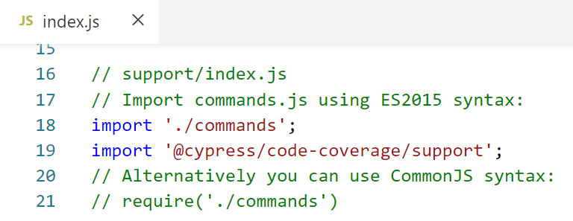
Cypress configuration

Slide 9
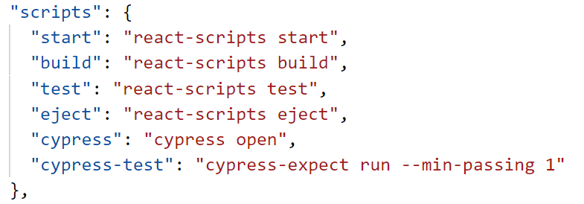
Cypress dependencies and scripts
$ npm i –D cypress cypress-expect @cypress/code-coverage

Slide 10
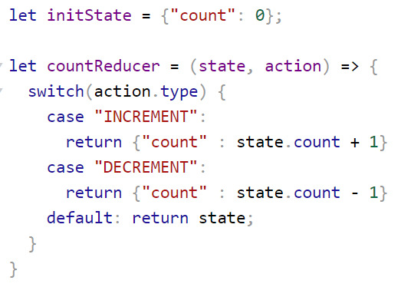
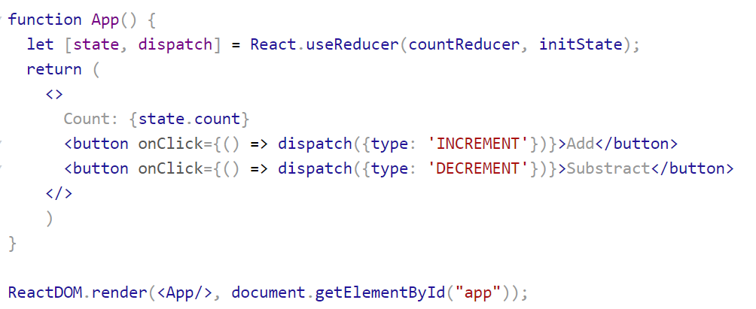
React Hooks
useReducer

Slide 11
Refs and the DOM
Refs provide a way to access DOM nodes or React elements created in the render method.
When to Use Refs
Managing focus, text selection, or media playback.
Integrating with third-party DOM libraries.

Slide 12
Creating Refs
Refs are created using React.createRef() and attached to React elements via the ref attribute.
class CustomTextInput extends React.Component {
constructor(props) {
super(props);
this.textInput = React.createRef();
this.focusTextInput = this.focusTextInput.bind(this);
}
focusTextInput() {
this.textInput.current.focus();
}
render() {
return (
<div>
<input
type="text"
ref={this.textInput} />
<input
type="button"
value="Focus the text input"
onClick={this.focusTextInput}
/>
</div>
);
}
}

Slide 13
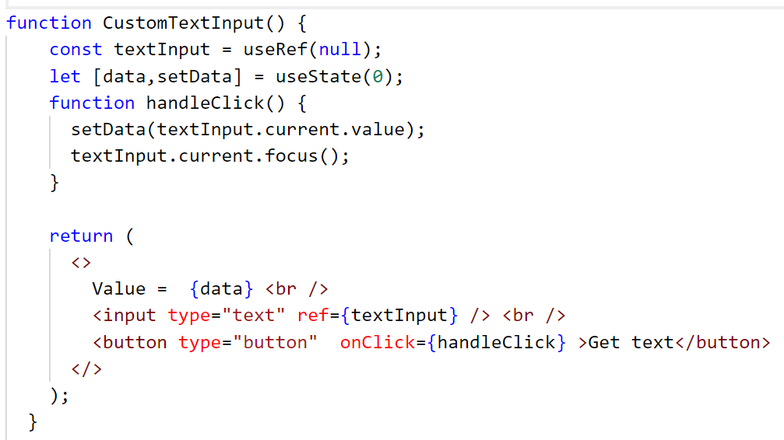
Refs and Function Components: useRef

Slide 14
Forwarding Refs
Ref forwarding is a technique for automatically passing a ref through a component to one of its children.
It can be useful for some kinds of components, especially in reusable component libraries.

Slide 15
forwardRef Example
const EmailInput = React.forwardRef((props, ref) => (
<input ref={ref} {...props} type="email" />
));
class App extends Component {
emailRef = React.createRef();
render() {
return (
<>
<EmailInput ref={this.emailRef} />
<button onClick={() => this.onClickButton()}> Click </button>
</>
);
}
onClickButton() {
this.emailRef.current.focus();
}
}

Slide 16
React Suspense
Start rendering even before the data has loaded
Pause any component until its data is ready
On a fast network, delay DOM mutations until the entire tree is complete
On a slow network, precisely control loading states

Slide 17
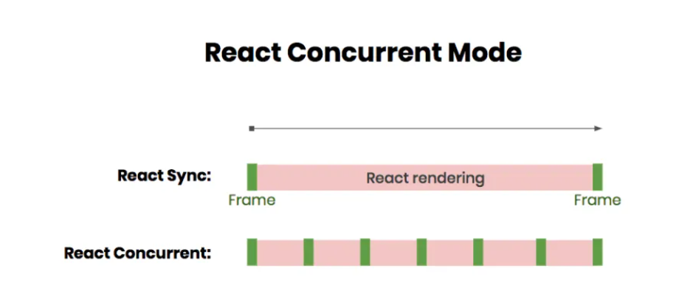
Concurrent Rendering
Concurrent Rendering allows apps to render the main thread and the other threads concurrently.
Concurrent rendering allows a responsive, smooth, and graceful transition during page loads.
It also considers the network speed, the layout, and the device in use.
Concurrent rendering solves many common page load issues like block rendering.

Slide 18
Performance
Optimizing for quality of user experience
Web Vitals is an initiative by Google to provide unified guidance for quality signals that are essential to delivering a great user experience on the web.

Slide 19
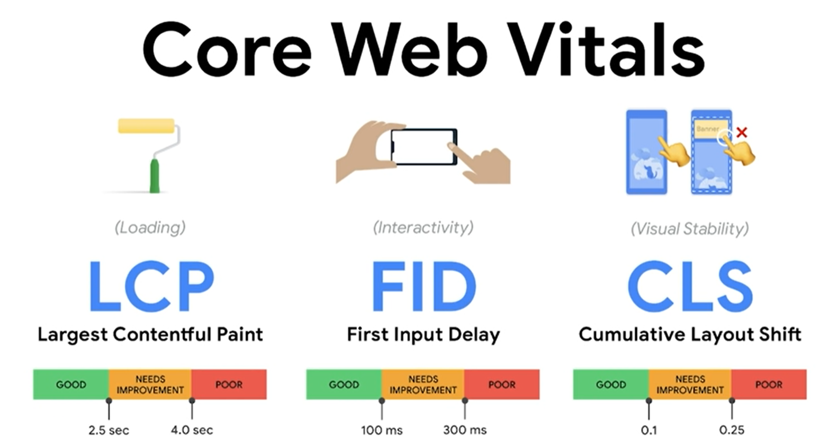
Core Web vitals

Slide 20
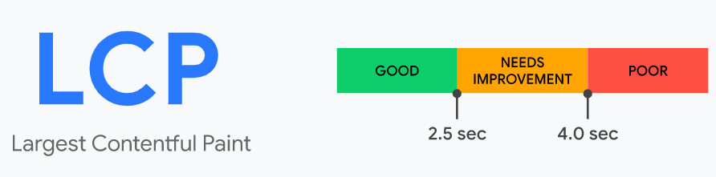
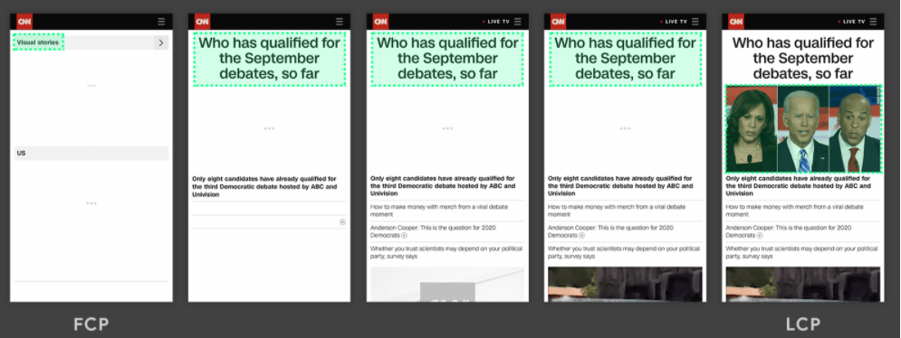
Core web vitals
LCP
The Largest Contentful Paint (LCP) metric reports the render time of the largest image or text block visible within the viewport.

Slide 21
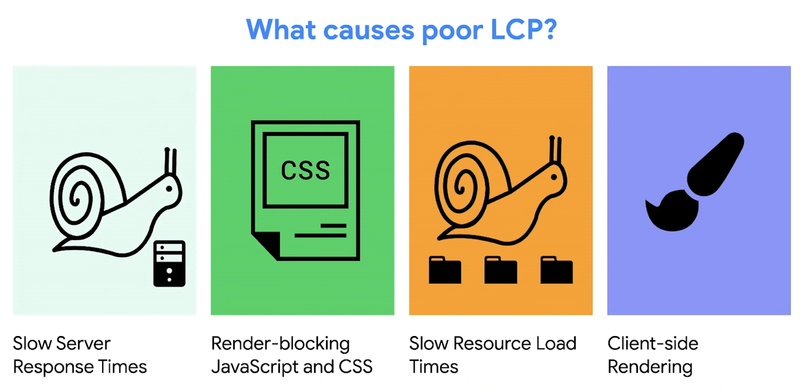
LCP

Slide 22
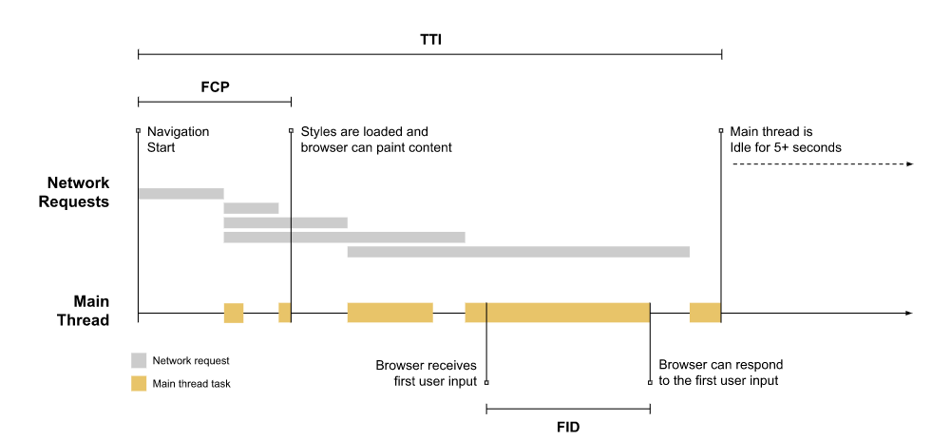
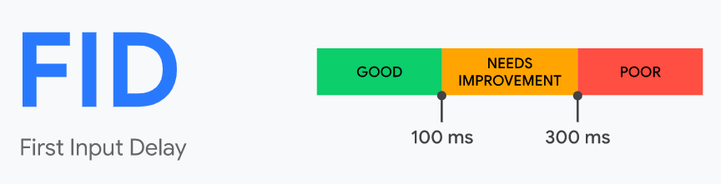
Core web vitals
First Input Delay (FID):
FID measures the time from when a user first interacts with a page (i.e. when they click a link, button, or use a custom JavaScript-powered control) to the time when the browser is actually able to begin processing event handlers in response to that interaction.

Slide 23
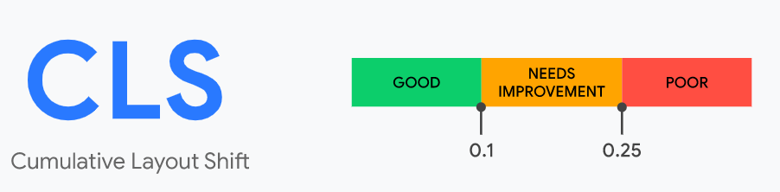
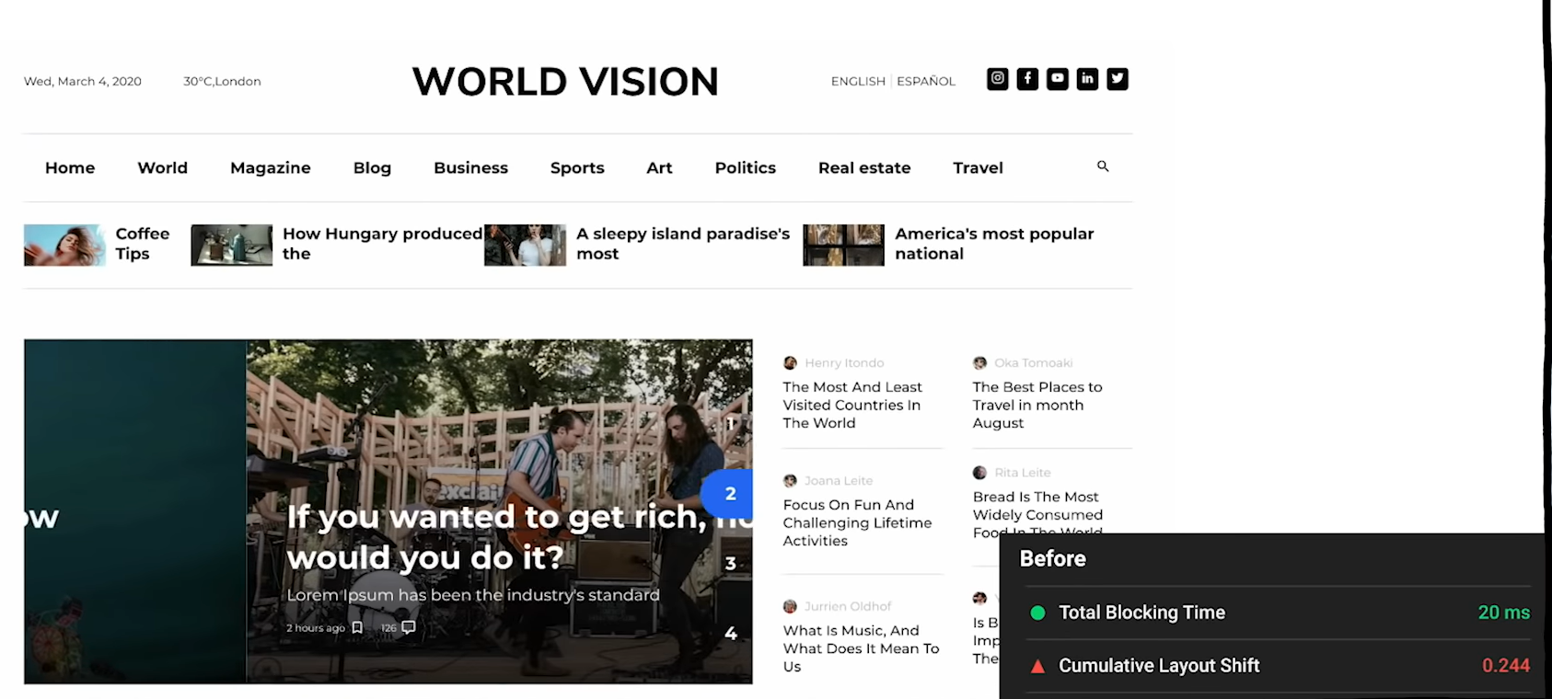
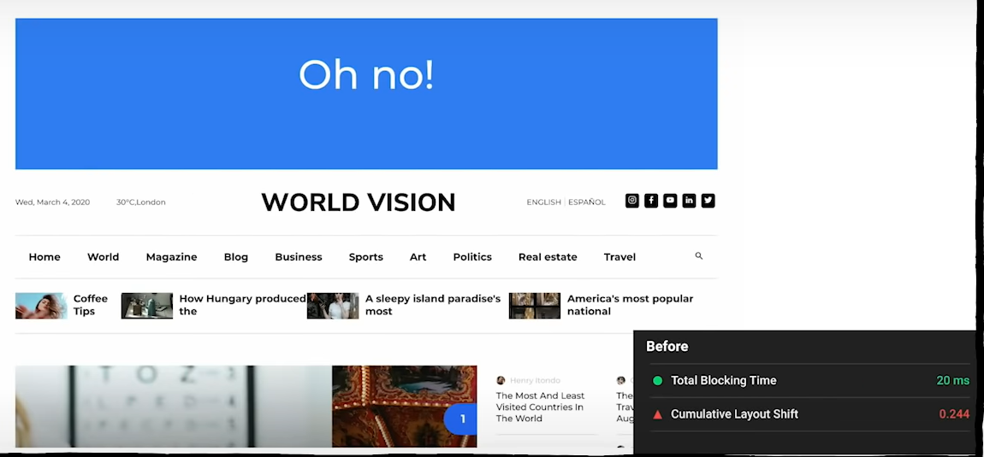
Core web vitals
CLS: Cumulative Layout Shift (CLS)
measures visual stability.
CLS measures the sum total of all individual layout shift scores for every unexpected layout shift that occurs during the entire lifespan of the page.

Slide 24


Core web vitals: CLS
Solution
Reserve enough place

Slide 25
web vitals
TTFB: Time to First Byte
Identifies the time at which your server sends the response
This audit fails when the browser waits more than 600ms for the server to respond to the main document request.
https://react-devtools-tutorial.now.sh/profiling

Slide 26
The React Profiler API
The React Profiler API measures renders and the cost of rendering to help identify slow bottlenecks in applications.
<Profiler id="Movies" onRender={callback}>
<Movies {...props} />
</Profiler>
const callback = (id, phase, actualTime, baseTime, startTime, commitTime) => {
console.log(`${id}'s ${phase} phase:`); // id: The "id" prop of the Profiler tree
// phase: "mount" or "update"
console.log(`Actual time: ${actualTime}`); // time rendering the committed update
console.log(`Base time: ${baseTime}`); // estimated time to render full subtree without memoization
console.log(`Start time: ${startTime}`); // time when Reach began rendering the update
console.log(`Commit time: ${commitTime}`); // time when React committed the update
}

Slide 27
The Interaction Tracing API
React has experimental support for interaction tracing via the interaction tracing API in the new scheduler package.
Interactions are annotated with a description (e.g " Add To Movies Queue click ") and a timestamp. Interactions should also be provided a callback where you can do work related to the interaction.
import { unstable_trace as trace } from "scheduler/tracing";
class MyComponent extends Component {
addMovieButtonClick = event => {
trace("Add To Movies Queue click", performance.now(), () => {
this.setState({ itemAddedToQueue: true });
});
};
}

Slide 28
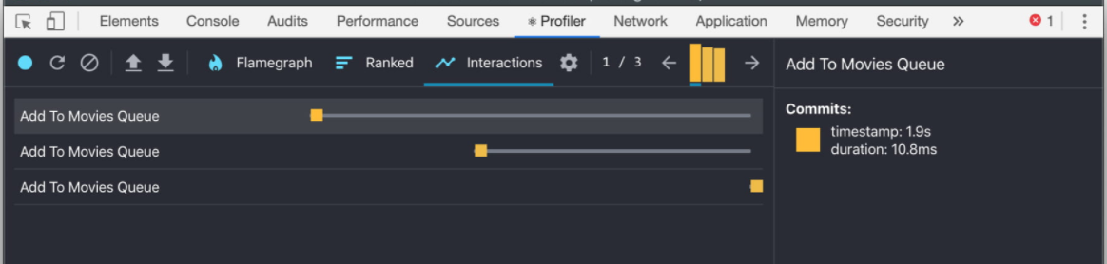
Interaction Tracing using React DevTools
We can record this interaction and see the duration for it presented in the React DevTools

Slide 29
User Timing API
The User Timing API enables measuring custom performance metrics for applications using high-precision timestamps.
window.performance.mark() stores a timestamp with the associated name
window.performance.measure() stores the time elapsed between two marks.
When you profile a React app using the Chrome DevTools Performance panel, you'll find a section called "Timings" populated with processing time for your React components.

Slide 30
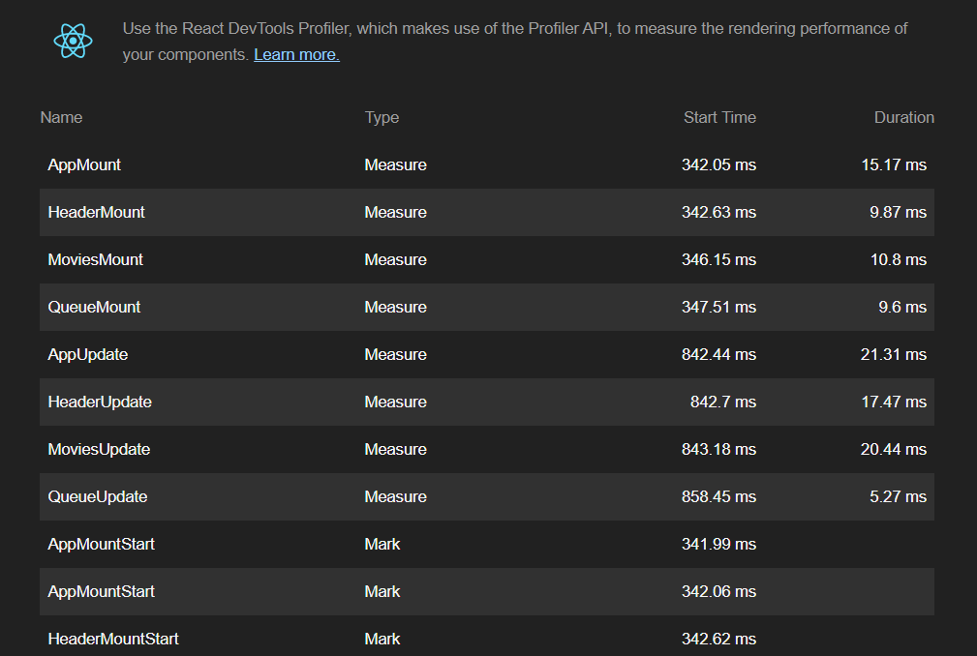
User Timing API
LightHouse

Slide 31
User Timing API
Using Chrome DevTools Performance panel

